Slide 1
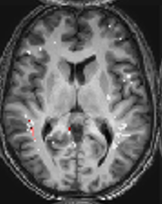
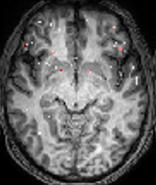
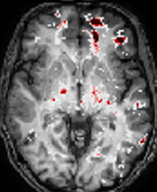
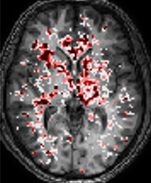





FIGURE 1: Epilepsy vs controls
A BBBD maps
2 3 4
1
5
4
3
B Regional Analysis
Z score
2
0
C Whole brain
D Regional analysis
Figure 1 DCE-MRI reveals persistent BBBD in epileptic patients. .(A) Examples of patients BBBD analysis results. 1 – healthy control. 2 – Left temporal epilepsy. 3 – Left frontal epilepsy. 4- Generalized epilepsy. (B) Examples of z-score 124 regions BBBD maps. Z-score between 0-2 is transparent. (C). Statistics of BBB% between controls and patients with epilepsy. (D) Statistics of Percent of regions with BBBD between controls and patients with epilepsy.
Notes:
Epilepsy 1 – AB_1866LFT
2 - MH 4108 LF
3 - WS_7206 G
Controls
1 – AN 0207
2 – HS 5404

Slide 2
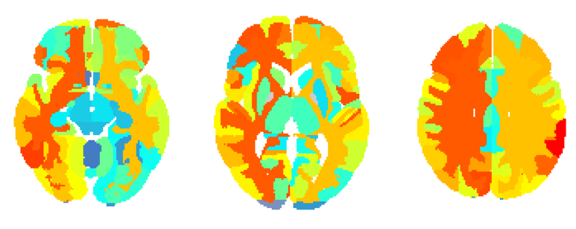
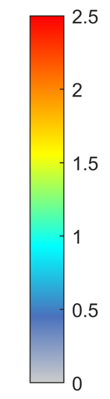
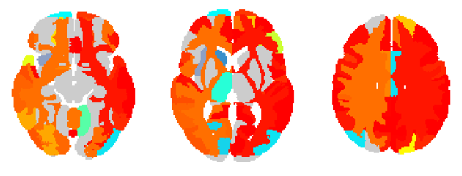
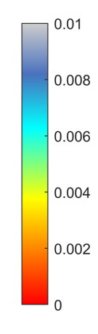
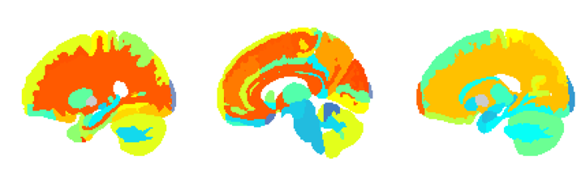
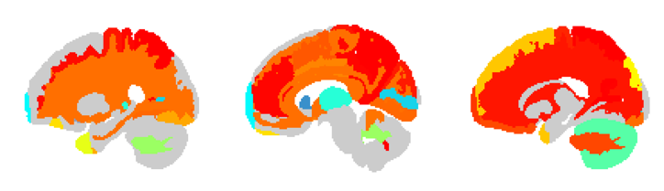
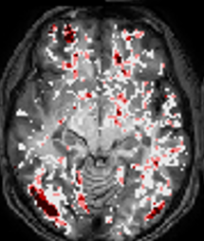

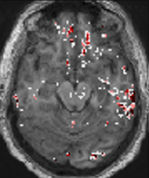

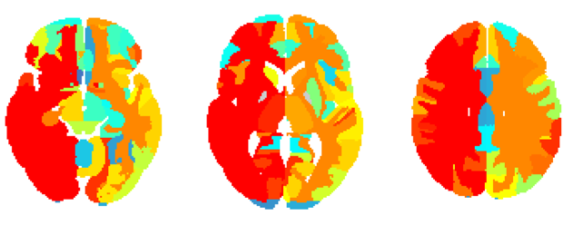
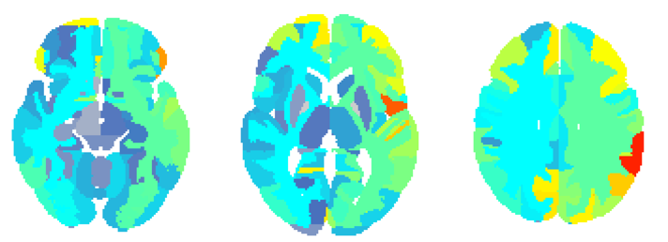
FIGURE 2: Regional analysis
A All PWE vs. controls
B All PWE vs. Controls
^{x}10⁻³
2.5
1
2
8
1.5
6
Z score
P value
1
4
0.5
2
0
0
C Generalized
D Temporal
5
4
3
Z score
2
0
2.5
2
1.5
Zscore
1
0.5
0
E All Patients
F
G Brain regions with BBBD
Figure 2 . (A) Averaged z-score above controls in regional maps of 126 areas. (B) Significant regions of patients with epilepsy compared to controls p<0.001. (C) 1. Example of patient with generalized epilepsy. Color bar same as fig.1. 2. Average z-score above controls in regional maps of generalized epilepsy (D) 1. Example of patient with suspected temporal epilepsy. Color bar same as fig.1 2. Average z-score above controls in regional maps of suspected temporal epilepsy (E) Averaged z-score per region of patients with epilepsy compared to controls (F) Averaged z-score of generalized and focal epilepsy per region. Exact values are provided in table S1(G) Percent of patients with averaged z-score >2 from controls.
Notes:
Examples:
EA 0804
LL 0265
BT 3007 – left side
Optional:
AF7084 – linear and tofts diffuse
BA 5372 – linear G and tofts F

Slide 3
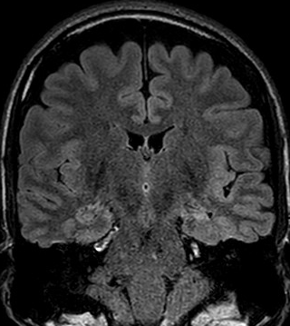
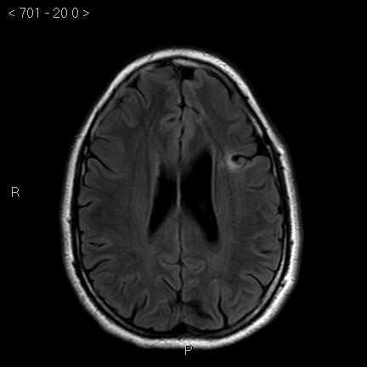
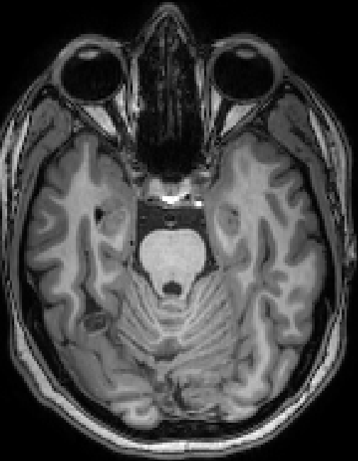
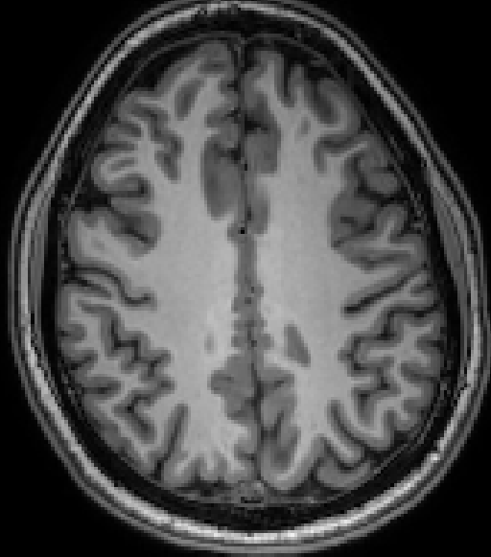
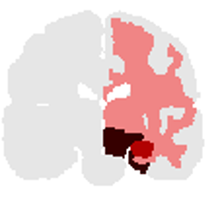



FIGURE 3: Lesion and BBBD
A
B
C
5
4
3
Z score
2
0
D E F
Figure 3 . BBBD in patients with a “lesional MRI”: A: 35 yo male with left hippocampal sclerosis. B: 33 yo man with left frontal cortical dysplasia. C: 20 yo female with right occipital cavernoma. Upper row: representative anatomical images showing the lesion (red circle). Lower row: regional analysis of BBB leakage. D: Location of region(s) with maximum BBBD in relation to lesion site.
E: Whole brain BBBD volume in Z score compared with controls. F: % of regions (out of 123) with BBBD (Z score > 2). For more details see Table
Notes:
A - MH_4108
B - BT_3007
C - RS_7023

Slide 4
FIGURE S1: Demographics
A Age
B Gender
C Age of onset
D Years of epilepsy
E Seizure frequency
Figure S1 . (A) Average percent of regions with BBBD versus age (p=0.63). (B) Average percent of regions with BBBD by gender (p=0.058). (C) Average percent of regions with BBBD versus age of onset (p=0.22). (D) Average percent of regions with BBBD versus years of epilepsy (p=0.79). (E) Average percent of regions with BBBD versus seizure frequency (p=0.39).

Slide 5
FIGURE S2: Medicine
A
B
C
D
Figure S2 . (A) Average percent of regions with BBBD by number of medications taken (N(0,1) = 17, N(2)=14, N(3+)=19. p(1,2 )=0.65 , p(1,3)=0.14 , p(2,3)= 0.46). (B) Distribution of PWE with low and high BBBD cutoff set at the median. (C) Average number of medication taken by PWE with low and high BBBD. (D) Percent of patients who take a medicine divided to low and high BBBD groups. (P=0.36, 0.63, 0.01,0.43, 0.39,0.2,0.87, 0.78, 0.78, 0.78).

